Slide 1
CRIME ANALYSIS
AMEYA
NEHA
DARSHAN

Slide 2
INSPIRATION
Crime analysis is a law enforcement function that involves systematic analysis for identifying and analyzing patterns and trends in crime and disorder.
Information on patterns can help law enforcement agencies deploy resources in a more effective manner, and assist detectives in identifying and apprehending suspects.
Crime analysis also plays a role in devising solutions to crime problems, and formulating crime prevention strategies.
Understanding the importance of these points, we decided to go ahead with the analysis of crime data.

Slide 3
DATASET
30,OOO rows
22 columns
Data has been collected from the period 2001 - 2019
Big query API used to obtain a csv file from the available dataset
Category – public safety
Tags – crime, police
Source – Chicago PD
Each of the 30,000 rows represents a reported crime

Slide 4
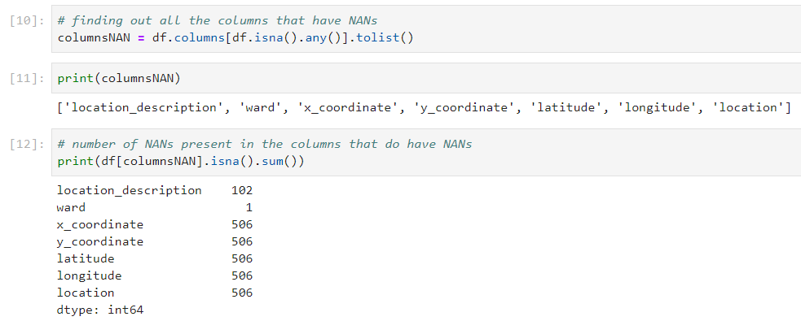
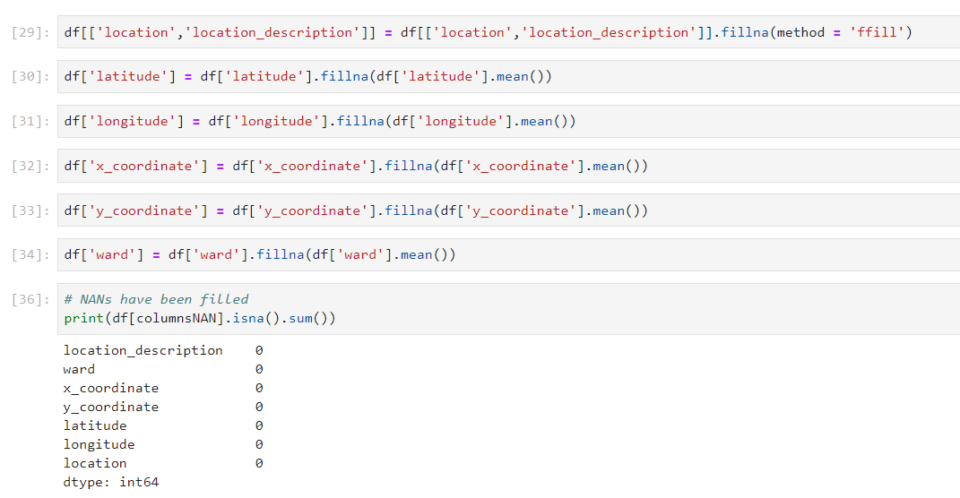
DATA CLEANING
After cleaning
Before cleaning

Slide 5
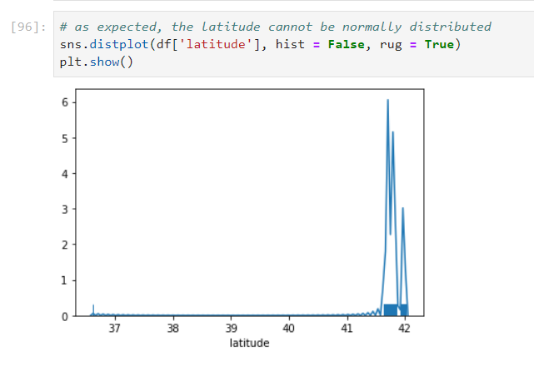
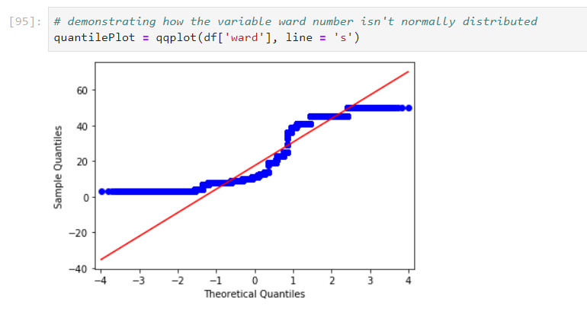
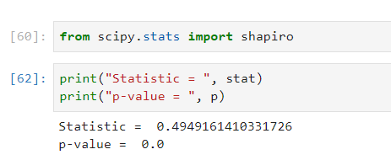
NORMALISATION

Slide 6
NORMALISATION
The above normality tests clearly indicate our data isn’t normally distributed.
As our intuition suggests, this being a statistical dataset on crime, all our columns are factual in nature.
It makes no sense to normalize them.

Slide 7
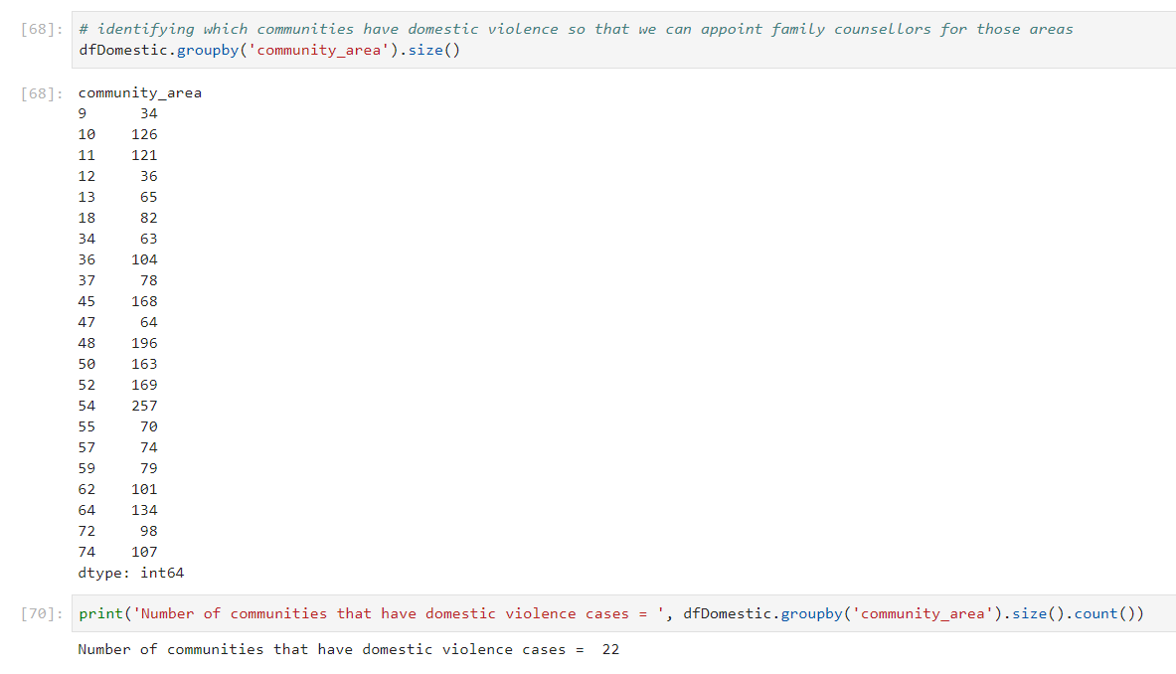
HYPOTHESIS TESTING
With domestic violence rising in recent times, there are around 25 communities that have registered cases pertaining to domestic violence.
NOT REJECTED

Slide 8
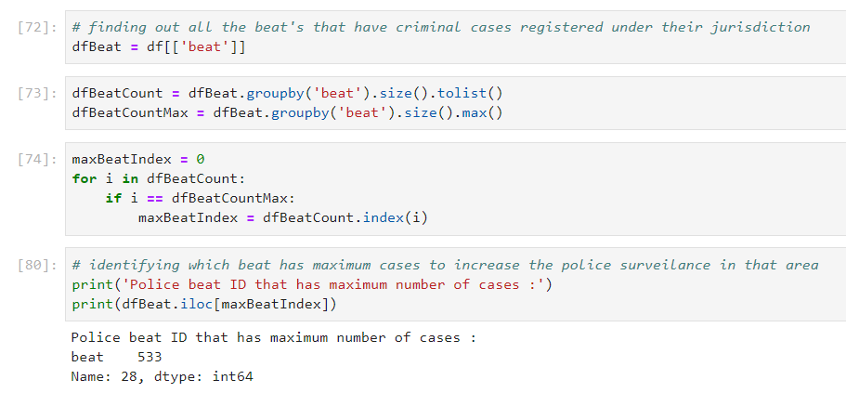
HYPOTHESIS TESTING
Police beat number 1133 have the most number of criminal cases registered based on a report by the Chicago Sun-Times.
REJECTED

Slide 9
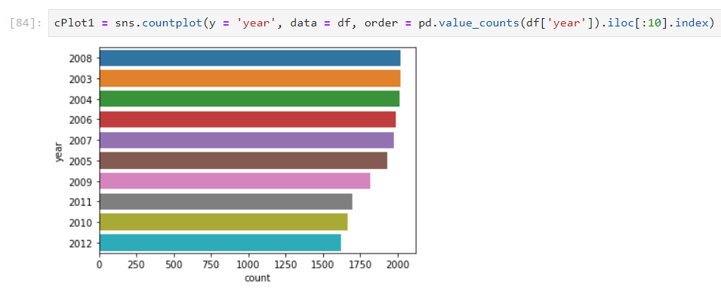
HYPOTHESIS TESTING
After the 2008 recession in the US, a lot of people lost their jobs, hence the crime rate would have increased.
NOT REJECTED

Slide 10
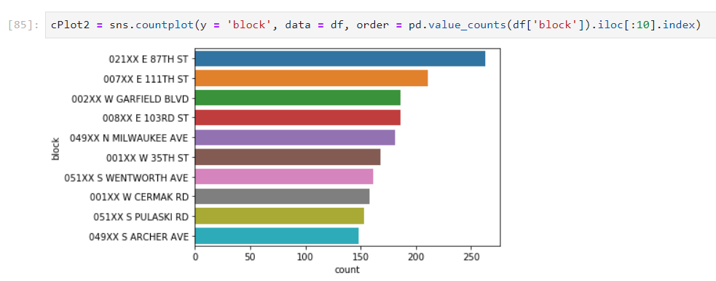
HYPOTHESIS TESTING
Areas having a majority black population account for a greater percentage of crimes.
The areas 87th Street & 111th Street ranked 1 & 2 respectively and have a black population of 40% which is relatively high when compared to other areas.
NOT REJECTED

Slide 11
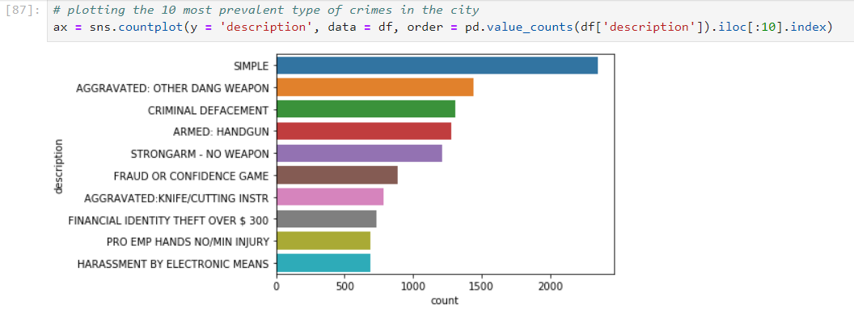
HYPOTHESIS TESTING
Gun related crimes are among the top 5 crimes in the city.
NOT REJECTED

Slide 12
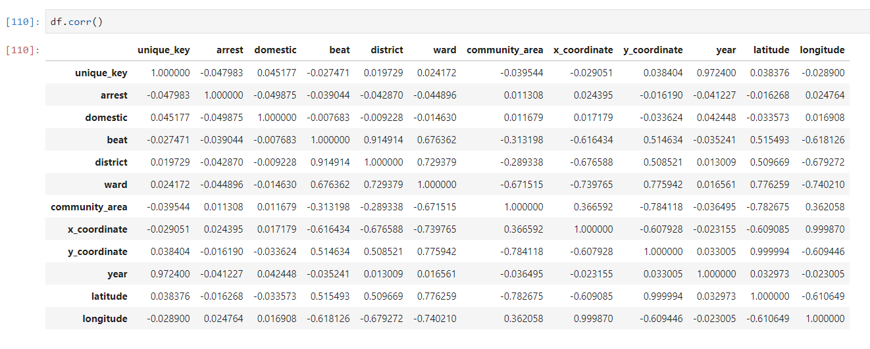
CORRELATION
A correlation table that tells us the magnitude of relationship between variables.

Slide 13
CONCLUSION AND FUTURE DEVELOPMENTS
By means of this project, we have drawn many meaningful insights into how crime is spread over the Chicago, IL.
For instance, we have been able to identify those areas where crime is more prevalent which keeps helps us keep the city police well informed about where they would require more vigilance at a given point in time.
We would like to take this a step further by analysing the crime activity in Bangalore and provide insights to the City Police, thereby making our home a safer place.

Slide 14
ACKNOWLEDGEMENT
We take this opportunity to thank our professor Jamuna Ma’am for helping us expand our knowledge in the field of Data Science through her insightful lectures delivered across these past 26 weeks.
All the materials that were shared with us during the course has helped us a great deal in completing the project. This project would’ve been incomplete without her guidance.
Thank You!

